Slide 1


Applied Statistics A.A. 2019/2020
Automated Chest X-Ray Diagnostics
Francesco Giammaria
Stefano Gusmeroli
Edoardo Peretti
Matteo Savino
Alessio Tranchida
Tutor: Dr. Daniele Loiacono

Slide 2



Automated Chest X-Ray Diagnostics
Applied Statistics A.A. 2019/2020
This is us
Stefano Gusmeroli
Edoardo Peretti
Matteo Savino
Alessio Tranchida
Francesco Giammaria

Slide 3
Automated Chest X-Ray Diagnostics
Applied Statistics A.A. 2019/2020
DATA PRESENTATION

Slide 4
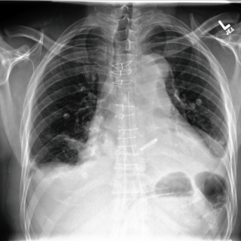
Automated Chest X-Ray Diagnostics
Applied Statistics A.A. 2019/2020
DATA PRESENTATION
More than 60,000 patients
More than 180,000 images
14 pathologies
input
output
Deep Convolutional Neural Network
(CNN)
Embeddings

Slide 5

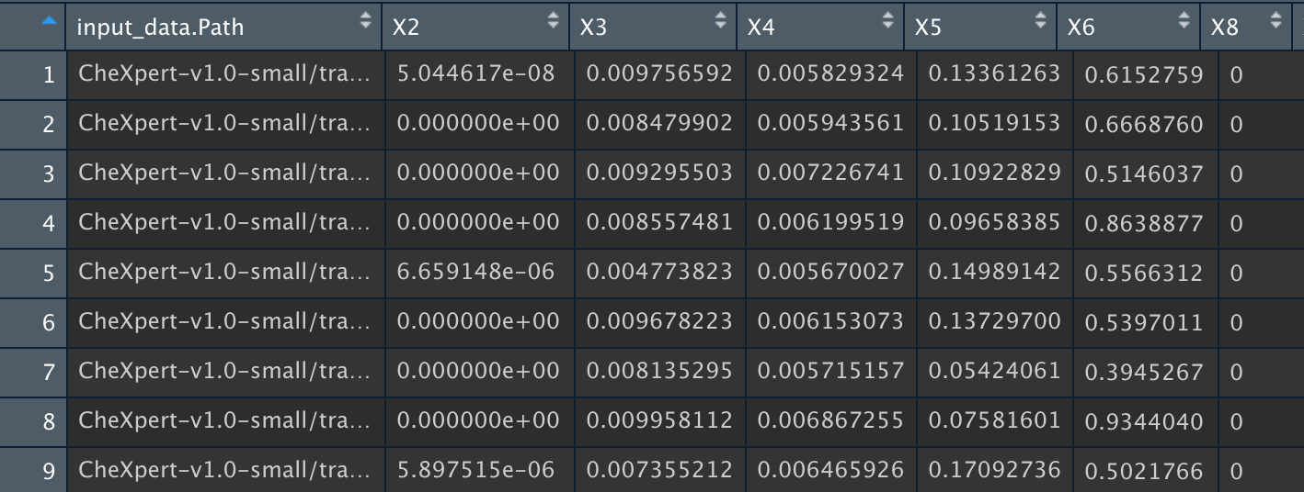
Automated Chest X-Ray Diagnostics
Applied Statistics A.A. 2019/2020
Embeddings
CNN
(189116 x 931)

Slide 6
Automated Chest X-Ray Diagnostics
Applied Statistics A.A. 2019/2020
14 pathologies

Slide 7
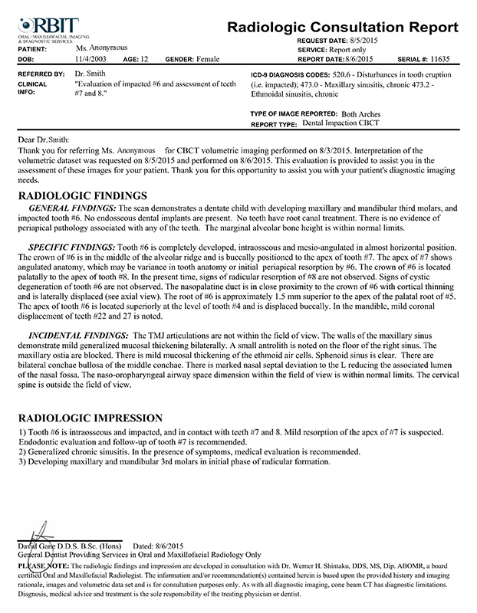
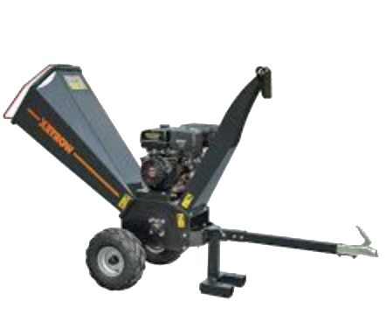
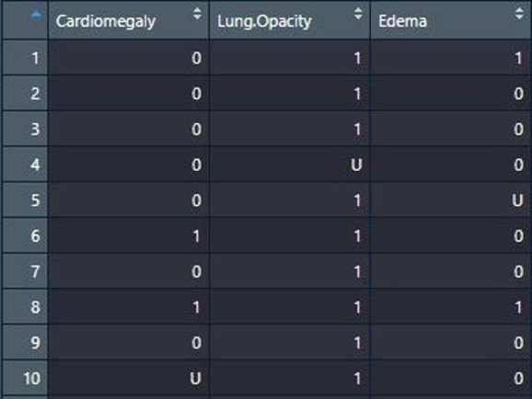
Automated Chest X-Ray Diagnostics
Applied Statistics A.A. 2019/2020
Labels
Labeler
Uncertainties

Slide 8
Automated Chest X-Ray Diagnostics
Applied Statistics A.A. 2019/2020
Guidelines
Embeddings Analysis
Treatment of Uncertainties
Pathologies Relationships

Slide 9

Automated Chest X-Ray Diagnostics
Applied Statistics A.A. 2019/2020
GRAPHICAL REPRESENTATION

Slide 10
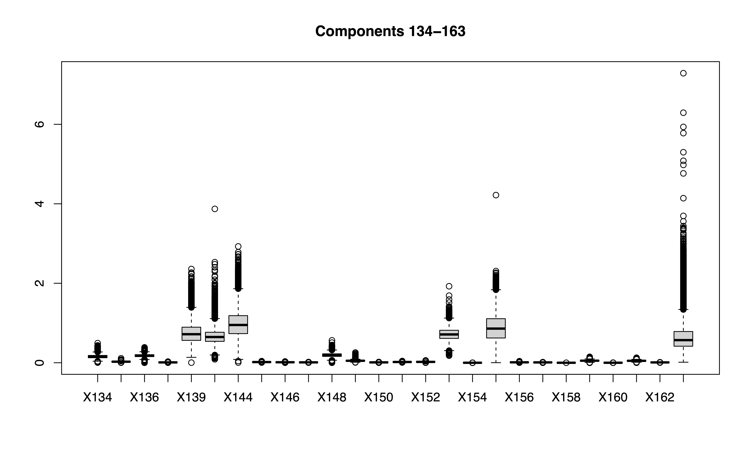
Automated Chest X-Ray Diagnostics
Applied Statistics A.A. 2019/2020

Slide 11
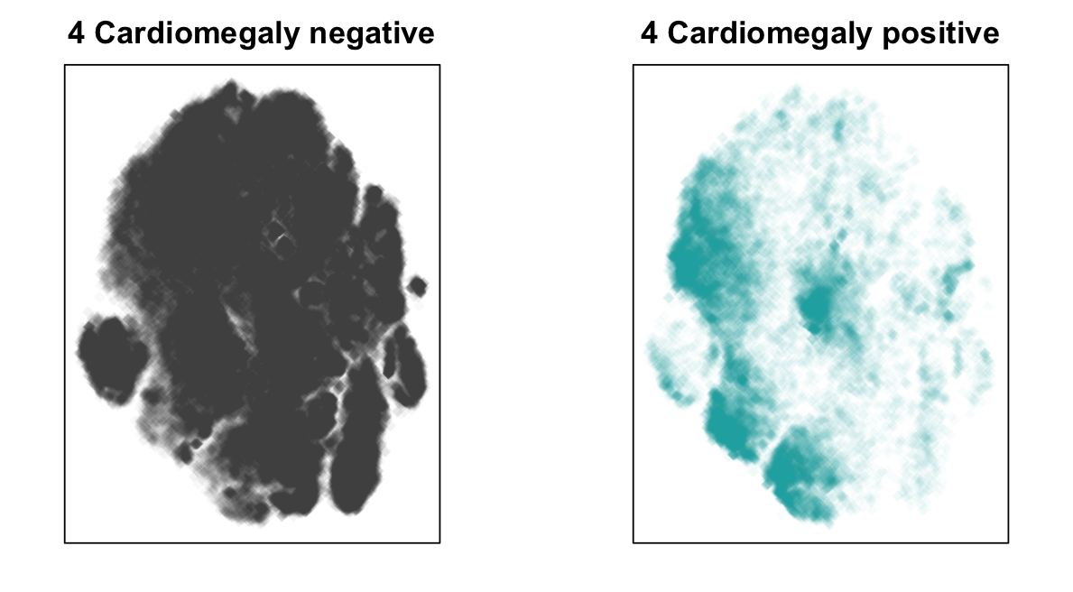
Automated Chest X-Ray Diagnostics
Applied Statistics A.A. 2019/2020
t-SNE (t-distibuted stochastic neighbor embedding)

Slide 12
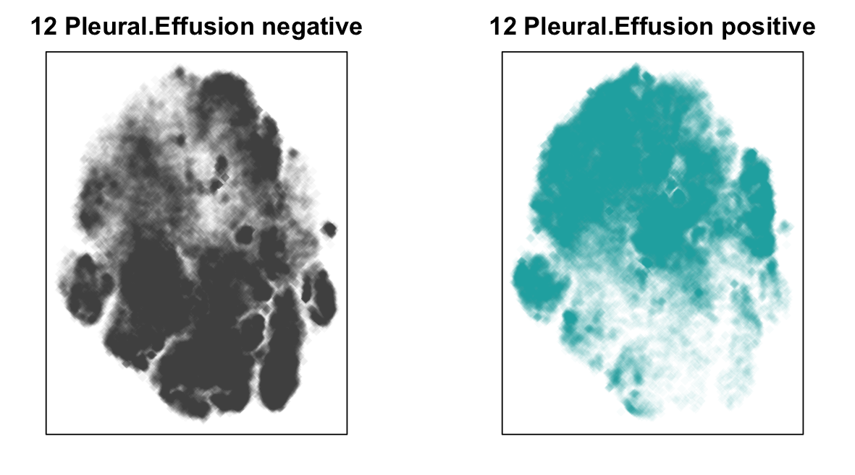
Automated Chest X-Ray Diagnostics
Applied Statistics A.A. 2019/2020
t-SNE

Slide 13
Automated Chest X-Ray Diagnostics
Applied Statistics A.A. 2019/2020
CLASSIFICATION MODELS

Slide 14
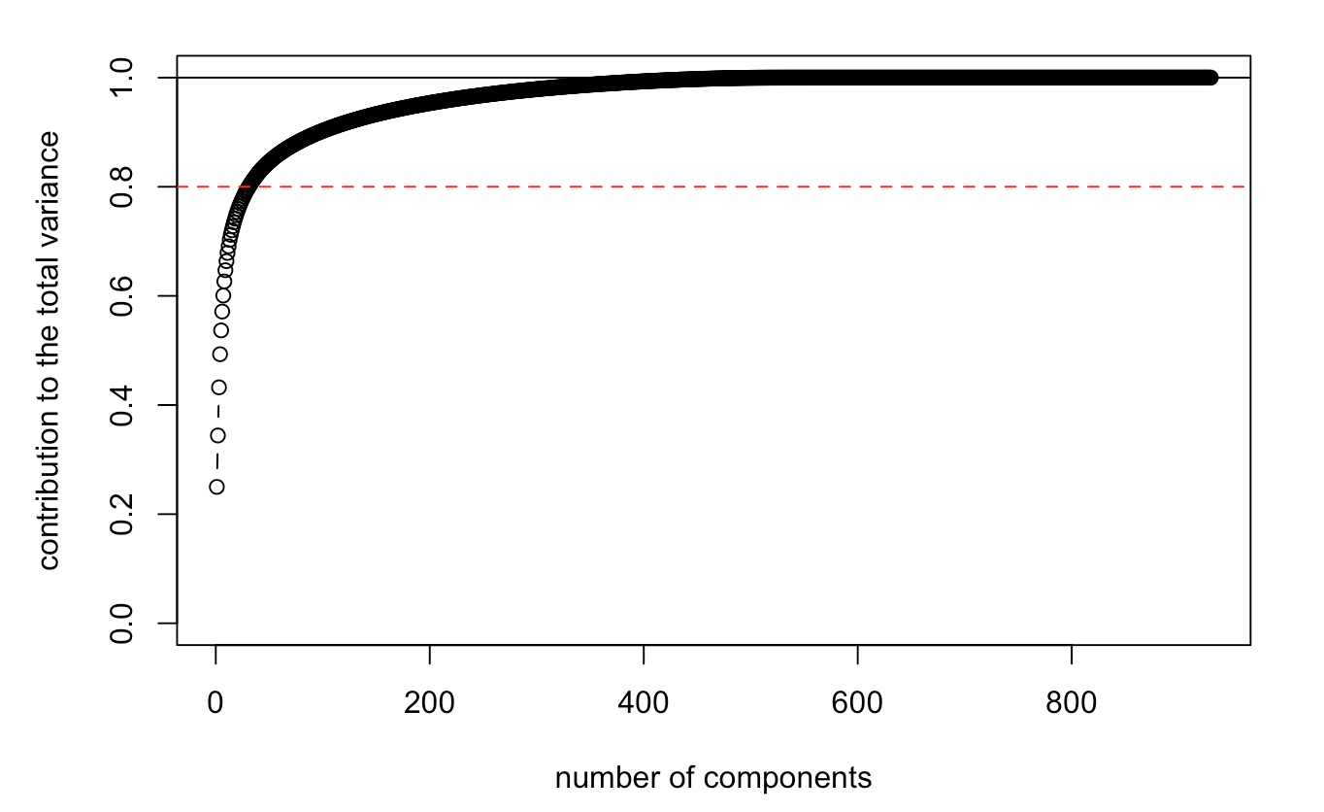
Automated Chest X-Ray Diagnostics
Applied Statistics A.A. 2019/2020
DIMENSIONALITY REDUCTION
PCA

Slide 15
Automated Chest X-Ray Diagnostics
Applied Statistics A.A. 2019/2020
LOGISTIC REGRESSION
RANDOM FOREST
Bagging Model
100 trees
features random selection
Quality of split: Gini index

Slide 16
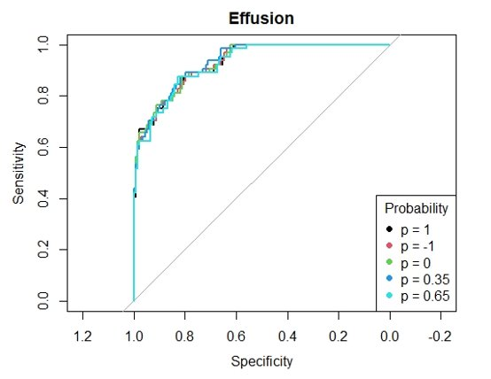
Automated Chest X-Ray Diagnostics
Applied Statistics A.A. 2019/2020
(Logit Models for different uncertainties)
Treatment of Uncertanties
Pleural Effusion
Uncertain values can be:
Discarded (p = -1)
All assigned to 0 (p = 0)
All assigned to 1 (p = 1)
Assigned to 1 with probability p

Slide 17
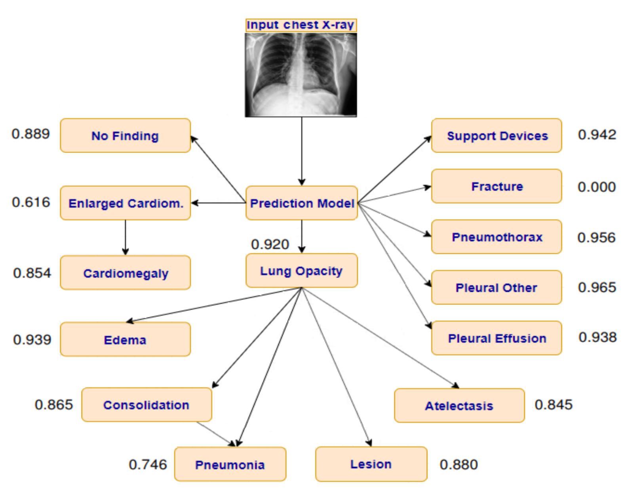
Automated Chest X-Ray Diagnostics
Applied Statistics A.A. 2019/2020
ASSOCIATIONS
[Pham et al. 2019]

Slide 18
Automated Chest X-Ray Diagnostics
Applied Statistics A.A. 2019/2020
Conditional Models
LUNG.OPACITY
EDEMA
EDEMA
X345 | X346 | X347 | X348 | X349 | X350 | X351 | X352 | X353 | Lung.Opacity
0.005 | 0.034 | 0.94 | 0.56 | 0.23 | 0.66 | 0.26 | 0.001 | 0.569 | 1
0.567 | 0.734 | 0.005 | 0.745 | 0.234 | 0.657 | 0.678 | 0.392 | 0.004 | 1
0.178 | 0.167 | 0.001 | 0.070 | 0.788 | 0.167 | 0.281 | 0.192 | 0.182 | 0
0.121 | 0.431 | 0.379 | 0.781 | 0.112 | 0.011 | 0.087 | 0.965 | 0.289 | 0
0.078 | 0.256 | 0.389 | 0.719 | 0.001 | 0.781 | 0.228 | 0.118 | 0.801 | 1

Slide 19
Automated Chest X-Ray Diagnostics
Applied Statistics A.A. 2019/2020
Corrected Labels
Edema | Lung. Opacity | Cardiomegaly
1 | u | 1
0 | u | 1
0 | 0 | 1
1 | 0 | 0
1 | 1 | 1
Edema | Lung. Opacity | Cardiomegaly
1 | 1 | 1
0 | u | 1
0 | 0 | 1
1 | 1 | 0
1 | 1 | 1

Slide 20
Automated Chest X-Ray Diagnostics
Applied Statistics A.A. 2019/2020
Conditional models:
increase in AUC up to 10÷20%, e.g. Cardiomegaly and Edema
Corrected labels: further increase of 1.5%

Slide 21
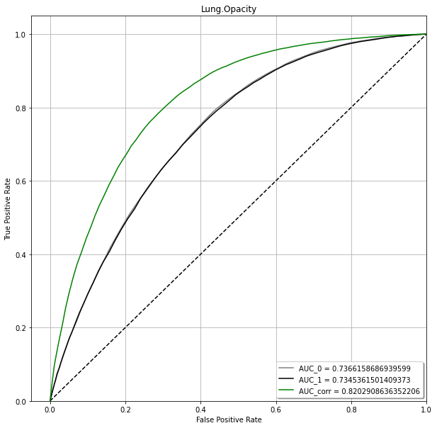
Automated Chest X-Ray Diagnostics
Applied Statistics A.A. 2019/2020
RANDOM FOREST
Lung.Opacity:
U = 0
U = 1
U = corrected

Slide 22
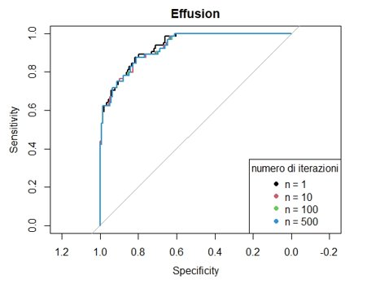
Automated Chest X-Ray Diagnostics
Applied Statistics A.A. 2019/2020
Bagging
Bagging: sample with replacement (bootstrap) + aggregation
Ensemble model with bootstrapped training sets
At each iteration uncertainties are resampled

Slide 23
Automated Chest X-Ray Diagnostics
Applied Statistics A.A. 2019/2020
CONCLUSION

Slide 24
Automated Chest X-Ray Diagnostics
Applied Statistics A.A. 2019/2020
CONCLUSION
✓ Conditional models are very useful
✓ Corrected labels are helpful
⨯ Treatment of uncertainties (because uncertainties << observations)
⨯ Bagging for logistic regression

Slide 25
Automated Chest X-Ray Diagnostics
Applied Statistics A.A. 2019/2020
THANK YOU
We look forward to answer your question!!!
If you want, join us at the following link:
https://github.com/edpere/CheXpert-analysis
CheXpert competition: https://stanfordmlgroup.github.io/competitions/chexpert/
Bibliography:
Interpreting chest X-rays via CNNs that exploit disease dependencies and uncertainty labels, Hieu H. Pham, Tung T. Le, Dat Q. Tran, Dat T. Ngo, Ha Q. Nguyen 2019
CheXpert: A Large Chest Radiograph Dataset with Uncertainty Labels and Expert Comparison, Jeremy Irvin, Pranav Rajpurkar, Michael Ko, Yifan Yu, et al.

Slide 28









Automated Chest X-Ray Diagnostics
Applied Statistics A.A. 2019/2020

Slide 29
Lasso
We looked for the optimal hyper-parameter 𝜶 using the validation set
In the end we do not see great improvements

Slide 30
Automated Chest X-Ray Diagnostics
Applied Statistics A.A. 2019/2020
Conclusions
✓ Conditional models are very useful
✓ Corrected labels can be helpful
⨯ Treatment of uncertainties (because of big dataset)
⨯ Bagging for logistic regression
⨯ Regularization (e.g. lasso) (no overfitting)

